Slide 1
Linked Building Data and Ontologies
Summer School of Linked Data in Architecture and Construction
June 10, 2024
Alex Donkers
a.j.a.donkers@tue.nl

Slide 2




Alex Donkers
Postdoctoral researcher
Eureka ITEA4 FireBIM
Information Systems in the Built Environment
Eindhoven University of Technology
Co-chair
W3C Linked Building Data Community Group
LBD

Slide 3
In this lecture, you’ll learn:
What an ontology is
Why we use ontologies
Basics of ontology engineering
The difference between Abox and Tbox
RDFS, Open World Assumption and the basics of reasoning
Common ontologies in the AEC industry
Practical tips and tools to kickstart your ontology development!

Slide 4
Ontology languages in semantic web stack
User interfaces & applications
Trust
Proof
Unifying logic
Querying
SPARQL
Models
OWL RDFS
Rules
RIF SHACL SWRL
Cryptography
Data interchange RDF
Syntax XML TTL JSON-LD
The web URI IRI HTTP UNICODE AUTH

Slide 5

A vocabulary is the set of words within a language that are familiar to that person
Classify terms that can be used in a specific context
Classify relationships between terms
Define constraints on using those terms
H. Sack. “Linked Data Engineering: 3.1 Vocabularies and Ontologies”

Slide 6
“
An ontology is a formal, explicit specification of a shared conceptualization
R. Studer, V. R. Benjamins, and D. Fensel. “Knowledge Engineering: Principles and methods”. In: Data & Knowledge Engineering 25.1-2 (1998), pp. 161–197. doi: 10.1016/S0169-023X(97)00056-6.

Slide 7
“
An ontology is a formal, explicit specification of a shared conceptualization
Conceptualization An abstract model of something in the world that we want to represent
Explicit All concepts in a domain are defined using formal logics supported by languages in the semantic web stack
Formal Machine-understandable
Shared Created for and agreed on by multiple users
R. Studer, V. R. Benjamins, and D. Fensel. “Knowledge Engineering: Principles and methods”. In: Data & Knowledge Engineering 25.1-2 (1998), pp. 161–197. doi: 10.1016/S0169-023X(97)00056-6.
Notes:
Shared: there is consensus Ontology vs

Slide 8
Level 0
Level 1
Level 2
Level 3
CAD
2D BIM
3D BIM
Federated BIM
Integrated BIM
Semantics
Ontologies
RDF, OWL, SPARQL
ICDD
Semantics
Proprietary formats
Proprietary formats and the development of domain-specific methods and standards
International standards (ISO)
IFC
IDM
IFD
Standards
Drawings
Geometric models
Domain-specific models
Architectural
Structural
HVAC
Asset management
Integrated, interoperable models
Information
Paper
Files
Central management of files in Common Data Environments
Cloud-based information and coordination
Collaboration
1990s
2000s
2010s
2020s

Slide 9
Developments in buildingSmart
Bespoke, high threshold
Generic, scalable, higher adoption
Standards
mvdXML
IDM
IFC
IFC
BCF
bcfAPI
Technology
STEP/
EXPRESS
UML
XML
Linked Data
JSON
Services
IfcDOC
bSDD
bSDD
GitHub
APIs

Slide 10

Semantic interoperability
DMSv2
BIM
GIS
€
DMS
Planning
DMS €
Notes:
Semantic web technologies enable this interoperability in a scalable manner.

Slide 11
Semantic interoperability
BIM
GIS
DMSv2
Ontology!
DMS
€
Planning
DMS €

Slide 12
..
How to represent an ontology?
Notes:
10:00

Slide 13
Ontologies are represented using
..
Classes
Abstract representation of a real-world concept
Relationships
Relationship between two classes or between a class and a literal
Literals
Data values, such as strings, booleans or integers
owl:datatypeProperty
rdfs:Literal
owl:Class
hasAddress
“Address”
Building
hasSpace
Space
owl:objectProperty
owl:Class

Slide 14
Slightly more complex ontology structures
..
Classes can have sub-classes
Building
hasAddress
“Address”
hasSpace
Space
hasWall
hasElement
Element
subClassOf
Wall
subClassOf
Door
Notes:
Subclass relationships can be replaced in a sentence by “Is a”. For example, Wall is an Element.
We cannot create this relationship between Wall and Building, because Wall is a Building does not make sense.
We can extend Wall again, e.g. Wall hasSubClass ExteriorWall.

Slide 15
Slightly more complex ontology structures
..
Rules can be defined for classes and relationships
Building
hasAddress
“Address”
Building has only 1 address
hasSpace
Space
hasWall
hasElement
Element
subClassOf
Wall
Wall ∩ Window = ∅
subClassOf
Door

Slide 16
Connecting ontologies
..
Relationships can connect classes from two ontologies
Building
equivalentClass
BuiltStructure
hasSpace
subClassOf
Space
hasWall
UniversityBuilding
hasElement
Element
subClassOf
Wall
subClassOf
Door

Slide 17
vs
Ontologies
Data
Notes:
17:00

Slide 18
vs
Ontologies
inCity
Building
City
Element
hasSpace
inCountry
type
Space
hasElement
Country
type
type
inCity
RUB-Makerspace
type
type
Bochum
Courtyard Windows
hasSpace
inCountry
Co-working Area
hasElement
Germany
Data

Slide 19
vs
Ontologies
ont:inCity
ont:Building
ont:City
ont:Element
ont:hasSpace
ont:inCountry
rdf:type
ont:Space
ont:hasElement
ont:Country
rdf:type
rdf:type
ont:inCity
inst:RUB-Makerspace
rdf:type
rdf:type
inst:Bochum
inst:CourtyardWindows
ont:hasSpace
ont:inCountry
inst:Co-workingArea
ont:hasElement
inst:Germany
Data

Slide 20
vs
Ontologies
ont:inCity
ont:Building
ont:City
ont:Element
ont:hasSpace
ont:inCountry
rdf:type
ont:Space
ont:hasElement
ont:Country
rdf:type
rdf:type
ont:inCity
inst2:Vertigo
rdf:type
rdf:type
inst2:Eindhoven
inst2:MyDesk
ont:hasSpace
ont:inCountry
inst2:Room9.09
ont:hasElement
inst2:TheNetherlands
Data

Slide 21
vs
Ontologies
inCity
Building
City
Element
hasSpace
inCountry
hasElement
Country
Space
inCity
Vertigo
Eindhoven
My Desk :D
hasSpace
inCountry
inCity
9.11
hasElement
RUB-Makerspace
The Netherlands
Bochum
Courtyard Windows
hasSpace
inCountry
hasElement
Co-working Area
Germany
Data

Slide 22
vs
Ontologies
equivalentClass
BuiltStructure
inCity
Building
subClassOf
City
Element
hasSpace
inCountry
hasElement
Country
Space
UniversityBuilding
inCity
Vertigo
Eindhoven
My Desk :D
hasSpace
inCountry
inCity
9.11
hasElement
RUB-Makerspace
The Netherlands
Bochum
Courtyard Windows
hasSpace
inCountry
hasElement
Co-working Area
Germany
Data
neighbours

Slide 23


vs
Ontologies
Abstract representation of concepts
Terminology box (Tbox)
Ontologies, Vocabularies, Taxonomies, Object type libraries (OTL), dictionaries, masterdata
Happens in ontology editors, such as Stanford Protégé
Unique real-world phenomena (or ‘things’)
Assertion box (Abox)
Instances, or data
Ontologies and Data are represented in different files
Happens in graph databases, such as GraphDB
Data

Slide 24
vs
Ontologies
RDFS, Open world assumption
and a bit of reasoning
Data
Notes:
24:00

Slide 25
Some basic RDFS: label and comment
https://www.w3.org/TR/rdf-schema/
ont:Building
rdfs:label
“Building”@en
rdfs:label
“Gebouw”@nl
ont:hasSpace
ont:Space
"An independent unit of the built environment with a characteristic spatial structure, intended to serve at least one function or user activity [ISO 12006-2:2013]. A bot:Building is a part of the physical world or a virtual world that is inherently both located in this world and having a 3D spatial extent, is contained in a building site, and can contain one or more storeys that are vertically connected."@en
rdfs:comment

Slide 26
Some basic RDFS: subclass and subproperty
ont:Building
ont:hasSpace
rdfs:subClassOf
rdfs:subPropertyOf
ont:UniversityBuilding
ont:hasBathroom

Slide 27
Some basic RDFS: domain and range
ont:Building
ont:hasSpace rdfs:domain ont:Building .
ont:hasSpace rdfs:range ont:Space .
ont:hasSpace
See that knowledge modeling in ontologies also can be done in the Turtle (.ttl) notation!
ont:Space

Slide 28
An example with rdfs:Domain
Relationships can have a domain and range, stating the expected class-membership of the subject and the object of a triple
If hasSpace has a domain Building and a range Space, a reasoner would do the following, even if you didn’t explicitly specify this in the Data
Ontology
Data
Reasoner
rdf:type
Building
RUB-Makerspace
RUB-Makerspace
Building
hasSpace
hasSpace
rdf:type
Space
Co-working Area
Co-working Area
Space

Slide 29
An example with rdfs:Domain
Be careful!
Ontology
Data
rdf:type
Building
Tesla Model S
Car
hasSpace
hasSpace
Reasoner
rdf:type
Space
Trunk
Tesla Model S
Building
Notes:
A tesla can both be a car and a building, which is a bit weird. But this is perfectly possible in the semantic web.

Slide 30
The Open World Assumption (OWA)
The assumption that a statement can be true, even if it is not known to be true.
Different from the Closed World Assumption: statements that are not known to be true are considered false.
Chimney
Query
Can CarlsHouse fly?
hasElement
Roof
CWA: No
OWA: We don’t know, but possibly yes
hasRoof
CarlsHouse

Slide 31

Balloon 2
Balloon 3
Balloon 1
Balloon 4
Balloon 5
Balloon 6
Chimney
hasElement
Roof
hasRoof
CarlsHouse

Slide 32
The Open World Assumption (OWA)
Mimics the real world
We, in the AEC industry, very often deal with incomplete information
OWA assumes that information is incomplete by default
We allow others to extend our knowledge graphs
However, be careful, because houses can fly, and cars can be buildings…
Rule checking requires a CWA (SHACL)

Slide 33
--
Linked Building Data Ontologies
Notes:
30:00

Slide 34

Where it all begun…

Slide 35
… to where we are now
Modular, small, lightweight ontologies
Plug-and-play
Core ontologies representing basic building information
Domain-specific ontologies representing specific knowledge
Notes:
I would very much advise you to read about ifcOWL, read some of the earlier papers on this topic, as it’s good to know some of the history. But we moved on.

Slide 36
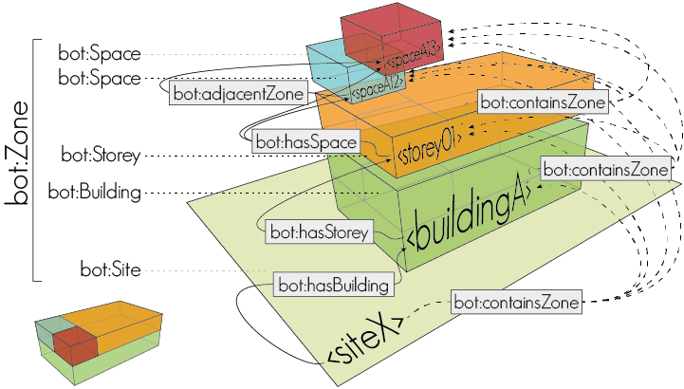
Building Topology Ontology BOT
@prefix bot: <https://w3id.org/bot#>
bot:Site
bot:hasBuilding
bot:Building
bot:containsZone
bot:Zone
bot:hasStorey
bot:Storey
bot:hasSpace
bot:Space
bot:hasElement
bot:Element
bot:hasSubElement

Slide 37
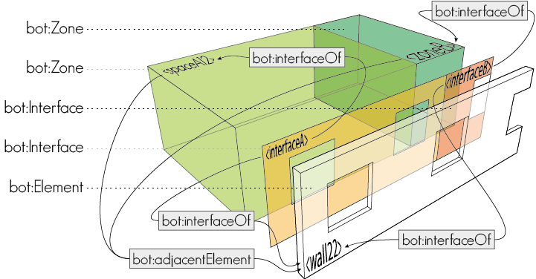
Building Topology Ontology BOT
@prefix bot: <https://w3id.org/bot#>
bot:interfaceOf
bot:Zone
bot:Interface
bot:hasElement
bot:Element
bot:interfaceOf

Slide 38
Let’s extend BOT
c:City
bot:Site
a:Geometry
bot:hasBuilding
bot:Building
bot:hasStorey
b:LectureRoom
bot:Storey
d:ThermalInsulation
bot:hasSpace
g:Temperature
bot:Space
d:Wall
bot:hasElement
bot:Element
e:Damage
f:Sensor

Slide 39
Let’s extend BOT with geometry
bot:Site
a:Geometry
bot:hasBuilding
bot:Building
bot:hasStorey
bot:Storey
bot:hasSpace
bot:Space
bot:hasElement
bot:Element

Slide 40
Ontology for Managing Geometry OMG
@prefix omg: <https://w3id.org/omg#>
<object>
omg:Geometry
“”^^geo:wktLiteral
omg:hasGeometry
omg:hasSimpleGeometryDescription

Slide 41
Ontology for Managing Geometry OMG
bot:Site
Combine BOT and OMG using an object property omg:hasGeometry
bot:hasBuilding
bot:Building
bot:hasStorey
bot:Storey
bot:hasSpace
bot:Space
bot:hasElement
bot:Element
omg:Geometry
“”^^geo:wktLiteral
omg:hasGeometry
omg:hasSimpleGeometryDescription

Slide 42
Let’s extend BOT
c:City
bot:Site
a:Geometry
bot:hasBuilding
bot:Building
bot:hasStorey
b:LectureRoom
bot:Storey
d:ThermalInsulation
bot:hasSpace
g:Temperature
bot:Space
d:Wall
bot:hasElement
bot:Element
e:Damage
f:Sensor

Slide 43
Let’s extend BOT with specific elements
bot:Site
bot:hasBuilding
bot:Building
bot:hasStorey
bot:Storey
bot:hasSpace
bot:Space
d:Wall
bot:hasElement
bot:Element
e:Damage

Slide 44
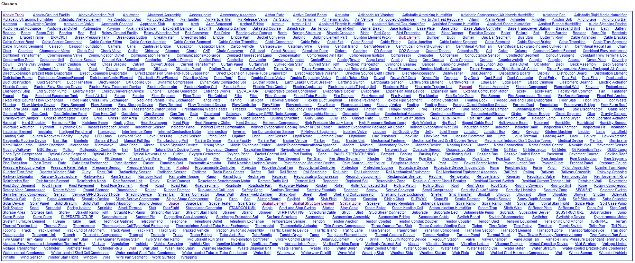
Built Element Ontology BEO
@prefix beo: <https://w3id.org/beo#>
beo:Product
rdfs:hasSubClass
beo:Element
rdfs:hasSubClass
beo:BuiltElement
rdfs:hasSubClass
beo:Wall
rdfs:hasSubClass
beo:ShearWall

Slide 45
Damage Topology Ontology DOT
@prefix dot: <https://w3id.org/dot#>
<object>
dot:Damage
dot:Causation
dot:hasDamage
dot:hasCausation

Slide 46
Built Element Ontology BEO
bot:Site
Combine BOT and BEO using a subclass of bot:Element
Combine BEO and DOT using an object property dot:hasDamage
bot:hasBuilding
bot:Building
bot:hasStorey
bot:Storey
bot:hasSpace
bot:Space
bot:hasElement
beo:Wall
dot:Damage
dot:Causation
dot:hasDamage
dot:hasCausation

Slide 47
Let’s extend BOT
c:City
bot:Site
a:Geometry
bot:hasBuilding
bot:Building
bot:hasStorey
b:LectureRoom
bot:Storey
d:ThermalInsulation
bot:hasSpace
g:Temperature
bot:Space
d:Wall
bot:hasElement
bot:Element
e:Damage
f:Sensor

Slide 48
Let’s extend BOT with sensor data
bot:Site
bot:hasBuilding
bot:Building
bot:hasStorey
bot:Storey
bot:hasSpace
g:Temperature
bot:Space
bot:hasElement
bot:Element
f:Sensor

Slide 49
Semantic Sensor Network SSN
@prefix ssn: <https://w3.org/ns/ssn/>
Sensor, Observation, Sample, and Actuator
@prefix sosa: <https://w3.org/ns/sosa/>
ssn:Property
sosa:hasProperty
sosa:FeatureOfInterest
sosa:observes
sosa:Sensor
sosa:hosts
sosa:Platform

Slide 50
Semantic Sensor Network SSN
@prefix ssn: <https://w3.org/ns/ssn/>
Sensor, Observation, Sample, and Actuator
@prefix sosa: <https://w3.org/ns/sosa/>
bot:Building
bot:hasStorey
bot:Storey
bot:hasSpace
ssn:Property
sosa:hasProperty
bot:Space, sosa:FeatureOfInterest
sosa:observes
bot:hasElement
sosa:Sensor
sosa:hosts
bot:Element, sosa:Platform, beo:Wall

Slide 51
All combined:
bot:Building
bot:hasStorey
bot:Storey
bot:hasSpace
ssn:Property
sosa:hasProperty
bot:Space, sosa:FeatureOfInterest
sosa:observes
bot:hasElement
sosa:Sensor
sosa:hosts
bot:Element, sosa:Platform, beo:Wall
dot:Damage
dot:Causation
dot:hasDamage
dot:hasCausation
omg:Geometry
“”^^geo:wktLiteral
omg:hasGeometry
omg:hasSimpleGeometryDescription
Notes:
This can be a bit complex. I would advise you to play around with this, starting with pen and paper. Just draw classes and relationships, draw the world around you, try to capture concepts and represent the real-world domain knowledge using graphs.

Slide 52
Common LBD ontologies
Buildings: BOT, DogOnt, SAREF4BLDG, REC, ifcOWL
Element taxonomies: BEO
Properties: OPM, BOP
Sensors: SOSA/SSN, SAREF, SEAS, BOP
Geometry: OMG, GeoSPARQL, GOM, FOG
HVAC: Brick
Provenance, metadata: PROV-O, DCAT, DublinCore
… and many, many more!

Slide 53
Ontology alignment
Tbox using formal alignment modules. E.g. Brick and Bot:
brick:Building owl:equivalentClass bot:Building .
Abox by simply using multiple rdf:type statements:
inst:RUB-Makerspace
rdf:type bot:Building, brick:Building .

Slide 54
Practical tips and tools
!
Notes:
45:00

Slide 55
Ontology design cycle
Specification: Determining the scope and purpose of the ontology, including its position in the semantic web landscape. Competency questions are formulated in this phase.
Knowledge acquisition: Defining the exact domain knowledge that the ontology should cover, based on a literature review.
Requirement specification: Making a list of classes, instances, object properties, and restrictions. Choices are based on the competency questions and the knowledge acquisition phase.
Building: Building the ontology using Stanford Protégé 5.5.0.
Evaluation: Testing the ontology in different use-cases. Testing SPARQL queries to validate the competency questions. Testing the ontology against evaluation criteria. Using the OntOlogy Pitfall Scanner! (OOPS!) to detect common pitfalls in the ontology.
Integration: Integrating the ontology with existing standards and ontologies.
Documentation and publication: Creating HTML documentation using WIDOCO. If possible, publish an example dataset, instantiating the ontology, under the CC-BY 4.0 license and provide example queries.
Donkers et al., 2022. https://doi.org/10.3390/buildings12101522
Specification
Knowledge acquisition Requirement specification Building Evaluation
Integration Documentation and publication

Slide 56
Ontology editors
User interface:
Stanford Protégé
TopBraid EDG
Laces Library Manager
Powerpoint:
Ontology Design Template
UML to OWL:
Chowlk
EA-to-RDF
Tips:
W3C Best Practices
W3C Cool URIs
Other W3C standards
!

Slide 57
Validators
Ontologies
OOPS!
Instance data
RDF TTL syntax validator
!

Slide 58
Publishing ontologies
Making HTML documentation
WIDOCO
LODE
Uploading to GitHub: https://github.com/w3c-lbd-cg/bot
Publish using GitHub Pages: https://w3c-lbd-cg.github.io/bot
!

Slide 59
Publishing ontologies (2)
Claiming a prefix: http://prefix.cc
Claim a w3 perma id: https://github.com/perma-id/w3id.org
Publish the ontology on Linked Open Vocabularies
Publish on bSDD (buildingSmart Data Dictionary)
Talk about it!
!

Slide 61

W3C Linked Building Data Group
If you like to contribute to those ontologies, discuss ongoing developments or learn from other academics and industry professionals, please join our W3C LBD CG. Triweekly technical meetings with presentations on linked building data.
LBD

Slide 62





Linked Building Data and Ontologies
Alex Donkers – PhD Candidate at Eindhoven University of Technology – a.j.a.donkers@tue.nl
Dujuan Yang, Bauke de Vries, Nico Baken

